Slide 1





Error Handling
Exception Responses, Exception Handlers, Global Handlers
SoftUni Team
Technical Trainers
Software University
https://softuni.bg

Slide 2
Table of Contents
Error Handling
Exception Responses
Controller-based Exception Handling
@ExceptionHandler
Global Application Exception Handling
@ControllerAdvice
Exception techniques use cases

Slide 3
Questions
sli.do #java-web

Slide 4

Error Handling
Anticipate! Detect! Resolve!

Slide 5
Error Handling
Error handling refers to:
The anticipation, detection and resolution of programming errors
The response & recovery procedures from error conditions
Error handling is necessary!
Improves user experience
Optimizes debugging
Facilitates code maintenance
Ensures product quality

Slide 6


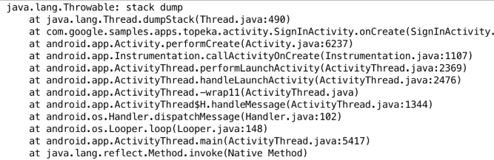

Error Handling Example
Oops…
We've encountered a problem! Don't worry, we are working on it!

Slide 7
Error Handling in Spring (1)
Spring MVC offers no default (fall-back) error page out of the box, however Spring Boot does
At start-up, Spring Boot tries to find a mapping for /error
Spring MVC provides several approaches to error handling
Per exception
Per controller
Globally

Slide 8
Error Handling in Spring (2)
Each option has its own use cases and circumstances
You can use:
Response-annotated custom exceptions
Controller-based handlers on specified actions
@ControllerAdvise annotated classes for global handlers

Slide 9
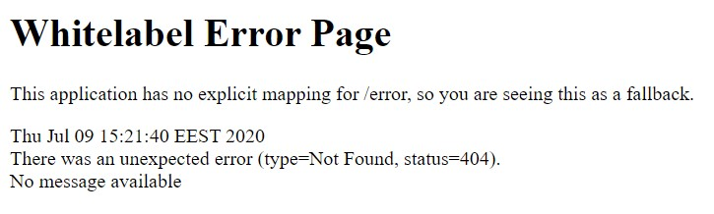
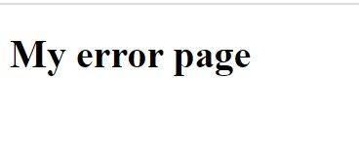
Custom error page
To disable the default White label error page for a Spring Boot application:
We must save error.html file in resources/templates directory, it'll automatically be picked up by the default Spring

Slide 10
ErrorController Interface (1)
Spring Boot maps /error to BasicErrorController which populates model with error attributes and then returns 'error' as the view name
To replace BasicErrorController with our own custom controller which can map to /error, we need to implement ErrorController interface

Slide 11
ErrorController Interface (2)
@Controller
public class MyErrorController implements ErrorController {
@RequestMapping
@ResponseBody
public String handle(HttpServletRequest request){
//Some code ...
}
}

Slide 12


HTTP Status Codes
Annotated Custom Exceptions

Slide 13
HTTP Status Codes
Unhandled exceptions during a request produce HTTP 500 response
Any custom exception can be annotated with @ResponseStatus
Supports all HTTP status codes
When thrown and unhandled – produces error page with appropriate response
@ResponseStatus(value = HttpStatus.NOT_FOUND, reason = "Product was not found.")
public class ProductNotFoundException extends RuntimeException {
// Exception definition
}

Slide 14
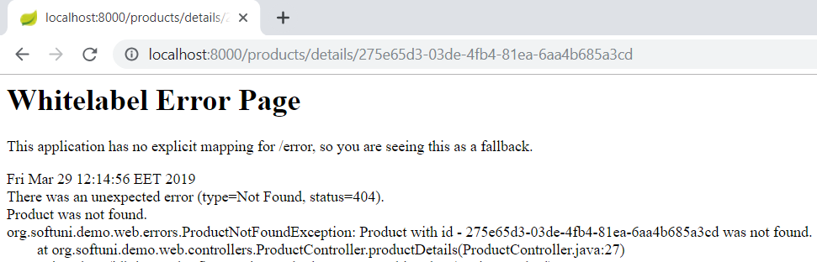
HTTP Status Codes
And the controller action, throwing the exception
@GetMapping("/products/details/{id}")
public ModelAndView productDetails(@PathVariable String id, ModelAndView modelAndView) {
Product product = this.productRepository.findProductById(id);
if(product == null) throw new ProductNotFoundException(id);
modelAndView.addObject("product", product);
return this.view("product/details", modelAndView);
}
The requested URL
The exception's message
The produced HTTP Status & Message

Slide 15

Controller-Based Error Handling
Exceptions & Views

Slide 16
Controller-Based Error Handling
You can define Controller-specific Exception Handlers
Annotated with @ExceptionHandler annotation
They work only for the Controller they are defined in
Can be annotated with @ResponseStatus to convert HTTP status
Can accept the caught exception as a parameter
Can return ModelAndView or String (view name)
Can catch multiple exception types

Slide 17
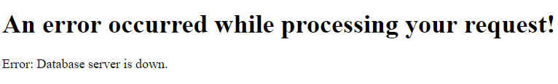
Controller-Based Error Handling
@ExceptionHandler({PersistenceException.class, TransactionException.class})
public ModelAndView handleDbExceptions(DatabaseException e) {
ModelAndView modelAndView = new ModelAndView("error");
modelAndView.addObject("message", e.getMessage());
return modelAndView;
}
Parent Exception
<html>
<head>...</head>
<body>
<h1>An error occurred while processing your request!</h1>
<p th:text="|Error: ${message}|"></p>
</body> </html>

Slide 18
Controller-Based Error Handling
Handler methods have flexible signatures
You can pass in servlet-related objects as parameters
HttpServletRequest
HttpServletResponse
HttpSession
Principal

Slide 19
Controller-Based Error Handling
The Model or ModelAndView cannot be a parameter though
Instead of passing it, you have to setup it inside the method
Nevertheless, this is not an issue because the IoC container would have done the same (pass an empty instance)

Slide 20
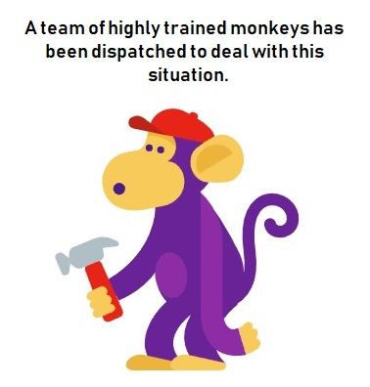
Controller-Based Error Handling
It is not a good practice for full error stacktraces to be exposed
Your users don't need to see ugly exception web-pages
You may even have security policies which strictly forbid any public exception info
Hide as much information as possible and present User-friendly error pages
For testing purposes you may view details
This may need an environment setup

Slide 21


Global Application Exception Handling
@ControllerAdvice Classes

Slide 22

Global Exception Handling (1)
There is a way to achieve Global exception handling in Spring
This is done through the @ControllerAdvise annotation
Any class annotated with @ControllerAdvise turns into an interceptor-like controller:
Enables global exception handling
Enables model enhancement methods

Slide 23
Global Exception Handling (2)
In @ControllerAdvice classes you still use @ExceptionHandler
However, this time it refers to the whole application
The error handling is not limited only to a specific controller
@ControllerAdvice
public class GlobalExceptionHandler {
@ExceptionHandler({TransactionException.class, PersistenceException.class})
public ModelAndView handleDatabaseErrors(DatabaseException e) {
ModelAndView modelAndView = new ModelAndView("index");
modelAndView.addObject("message", e.getMessage());
modelAndView.addObject("stack", {...} /* Formatted Stack Trace */);
return modelAndView;
}}

Slide 24
Global Exception Handling (REST) (1)
RESTful requests may also generate unexpected exceptions
HTTP Error response codes are a good choice
However sometimes you might need more than just a status
Customized Error Object, which can be presented on the Client
Limited Information returned to the Client

Slide 25



Global Exception Handling (REST) (2)
You can customize the Error Response by introducing a class
The Error Handler itself remains the same as in casual web apps
public class ErrorInfo {
public final String url;
public final String ex;
public ErrorInfo(String url, Exception ex) {
this.url = url;
this.ex = ex.getLocalizedMessage();
}
}

Slide 26
Global Exception Handling (REST) (3)
@ControllerAdvice
public class GlobalRESTExceptionHandler { @ResponseStatus(HttpStatus.INTERNAL_SERVER_ERROR)
@ExceptionHandler({TransactionException.class,
PersistenceException.class})
public @ResponseBody ErrorInfo handleRESTErrors(HttpServletRequest req,
DbException e) {
return new ErrorInfo(req.getRequestURL(), ex);
}
}

Slide 27
HandlerExceptionResolver Interface
HandlerExceptionResolver
DefaultHandlerExceptionResolver
SimpleMappingExceptionResolver
ResponseStatusExceptionResolver

Slide 28

Exception Techniques Use Cases
What to Use When?

Slide 29
What to Use When?
Spring offers many choices, when it comes to error handling
Be careful mixing too many of these
You may not get the behavior you wanted
There are some semantics, that should be followed, though

Slide 30
Exception techniques use cases
For custom exceptions, consider adding @ResponseStatus to then
For Controller-specific exceptions, @ExceptionHandler methods should be added alongside the actions
For all other exceptions, @ExceptionHandler methods in @ControllerAdvice classes should be implemented

Slide 31

Exception Handling
Live Demonstration

Slide 32

Summary
Error Handling is essential
Improves User Experience
Improves Application maintenance
Error Handling in Spring
HTTP Error Response Status Codes
@ExceptionHandler methods
@ControllerAdvice global handlers
Exception techniques use cases
…
…
…

Slide 33
Questions?
Notes:
33

Slide 34














SoftUni Diamond Partners

Slide 35

Educational Partners

Slide 36
Trainings @ Software University (SoftUni)
Software University – High-Quality Education, Profession and Job for Software Developers
softuni.bg, about.softuni.bg
Software University Foundation
softuni.foundation
Software University @ Facebook
facebook.com/SoftwareUniversity
Software University Forums
forum.softuni.bg
Notes:
36

Slide 37

License
This course (slides, examples, demos, exercises, homework, documents, videos and other assets) is copyrighted content
Unauthorized copy, reproduction or use is illegal
© SoftUni – https://about.softuni.bg/
© Software University – https://softuni.bg
Notes:
37

